Slide 1

Chapter 10
Creating Functions

Slide 2
Objectives
How to write your own functions that perform specific tasks.
How to pass information to a function.
How to use default values in a function.
How to have a function return a value.
How functions and variables work together.

Slide 3
Creating and Using Simple Functions
You’ll discover that you use certain sections of code frequently.
A self-defined function can save you time and make your programming easier.
The actions of a function take place each time the function is called.
The syntax for creating a user-defined function is.
function function_name() {
statement(s);
}
For example.
function whatever() {
print 'whatever';
}
PHP Functions - https://www.w3schools.com/php/php_functions.asp

Slide 4
Creating and Using Simple Functions
Naming functions.
Use roughly the same naming conventions for functions as you do for variables.
Just without the initial dollar sign.
Create meaningful function names.
For example, create_header would be a better function name than function1.
Do not use spaces in the name.
Use the underscore to represent a space.
Function names in PHP are not case-sensitive.
But you should still stick with a consistent naming scheme.

Slide 5
Creating and Using Simple Functions
Any valid PHP code can go within the statement(s) area.
Make sure you end each statement with a semicolon.
It’s conventional to indent a function’s statement(s).
You call (or invoke) the function by referring to it by name.
For example.
The following runs the previously defined function.
The whatever() function runs the print ‘whatever’; statement.
whatever();

Slide 6
Try it yourself
// Create the function.
function whatever() {
print 'whatever';
}
// Call the function.
whatever();
Output should display the word whatever.
phpfiddle.org

Slide 7
To create and call a basic function
Code from menus.php (Script 10.1).
The function defined in this script creates three pull-down menus for a form.
function make_date_menus() { $months = [1 => 'January', 'February', 'March', 'April', 'May', 'June' , 'July', 'August', 'September', 'October', 'November', 'December']; // Make the month pull-down menu: print '<select name="month">'; foreach ($months as $key => $value) { print "\n<option value=\"$key\">$value</option>"; } print '</select>';
... } // End of make_date_menus() function.
Make the form tags, and call the function.
print '<form action="" method="post">'; make_date_menus(); print '</form>';

Slide 8
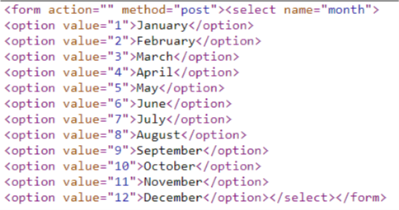
Try it yourself
function make_date_menus() {
$months = [1 => 'January', 'February', 'March', 'April', 'May', 'June'
, 'July', 'August', 'September', 'October', 'November', 'December'];
// Make the month pull-down menu:
print '<select name="month">';
foreach ($months as $key => $value) {
print "\n<option value=\"$key\">$value</option>";
}
print '</select>';
} // End of make_date_menus() function.
print '<form action="" method="post">';
make_date_menus();
print '</form>';
Use ‘view frame source’ in the browser.
phpfiddle.org

Slide 9
Creating and Calling Functions That Take Arguments
The input passed to a function is known as an argument or parameter.
The syntax for writing functions that take arguments is.
function function_name ($arg1,$arg2, ...) {
statement(s);
}
For example.
function make_full_name($first, $last) {
print $first . ' ' . $last;
}

Slide 10
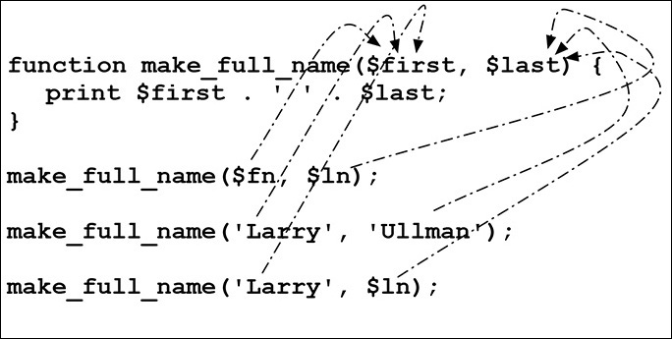
Creating and Calling Functions That Take Arguments
You can call the function either by passing variables.
make_full_name($fn, $ln);
Or by sending literal values.
make_full_name('Larry', 'Ullman');
The first variable in the function definition is assigned the first value in the call line, the second variable is assigned the second call value, and so forth.

Slide 11
Try it yourself
// Create the function.
function make_full_name($first, $last) {
print $first . ' ' . $last;
}
// Call the function.
make_full_name('Larry', 'Ullman');
Output should display the name Larry Ullman.
phpfiddle.org

Slide 12
To create and call a function that takes an argument
Code from sticky1.php (Script 10.2).
The make_text_input() function takes two arguments.
function make_text_input($name, $label) { // Begin a paragraph and a label: print '<p><label>' . $label . ': ';
// Begin the input: print '<input type="text" name="' . $name . '" size="20" ';
// Add the value: if (isset($_POST[$name])) { print ' value="' . htmlspecialchars($_POST[$name]) . '"'; }
// Complete the input, the label and the paragraph: print '></label></p>'; } // End of make_text_input() function.

Slide 13
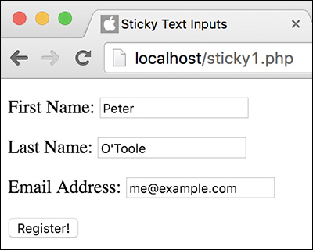
To create and call a function that takes an argument
Code from sticky1.php (Script 10.2).
Make the form tags, and call the function.
// Make the form: print '<form action="" method="post">';
// Create some text inputs: make_text_input('first_name', 'First Name'); make_text_input('last_name', 'Last Name'); make_text_input('email', 'Email Address');
print '<input type="submit" name="submit" value="Register!"></form>';

Slide 14
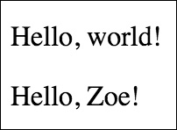
Setting Default Argument Values
PHP allows functions to have default argument values.
Just assign a value to the parameter in the function definition.
The function will use the preset value unless it receives another value.
function greeting($who = 'world') {
print "<p>Hello, $who!</p>";
}
For example.
greeting();
greeting('Zoe');
Calling the function without any arguments uses the default value (the first greeting).
Calling it with an argument provided means that value will be used instead (the second).

Slide 15
Try it yourself
// Create the function.
function greeting($who = 'world') {
print "<p>Hello, $who!</p>";
}
// Call the function.
greeting();
greeting('Zoe');
Output should display
Hello, world!
Hello, Zoe!
phpfiddle.org

Slide 16
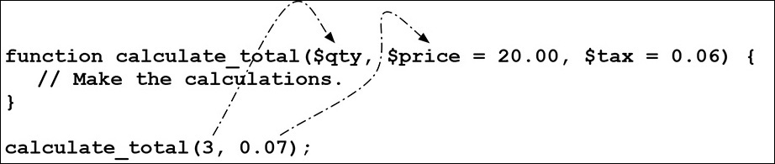
Setting Default Argument Values
The parameters with default values must always be written after the other parameters.
It isn’t possible to omit a value for the first argument but include one for the second.
function calculate_total($qty, $price = 20.00, $tax = 0.06) {...}
The improper way to call the function.
calculate_total(3, 0.07);
The proper way to call the function.
calculate_total(3, 20.00, 0.07);

Slide 17
To write a function that uses default values
Code from sticky2.php (Script 10.3).
The make_text_input() function takes three arguments.
// A third argument is optional (it has a default value). function make_text_input($name, $label, $size = 20) { // Begin a paragraph and a label: print '<p><label>' . $label . ': '; // Begin the input: print '<input type="text" name="' . $name . '" size="' . $size . '" '; // Add the value: if (isset($_POST[$name])) { print ' value="' . htmlspecialchars($_POST[$name]) . '"'; } // Complete the input, the label and the paragraph: print '></label></p>'; } // End of make_text_input() function.

Slide 18
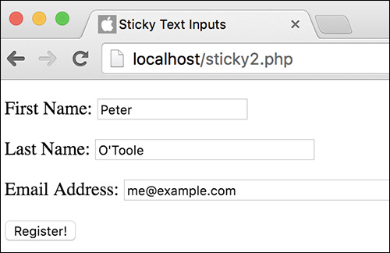
To write a function that uses default values
Code from sticky2.php (Script 10.3).
Make the form tags, and call the function.
// Make the form: print '<form action="" method="post">';
// Create some text inputs: make_text_input('first_name', 'First Name'); make_text_input('last_name', 'Last Name', 30); make_text_input('email', 'Email Address', 50);
print '<input type="submit" name="submit" value="Register!"></form>';

Slide 19
Creating and Using Functions That Return a Value
To return a value use the following two more steps.
Use the return statement within the function.
Use the output somehow when you call the function.
Basic format for a function that takes two arguments and returns a value.
function make_full_name ($first, $last) {
$name = $first . ' ' . $last;
return $name;
}
For example.
The first assigns the returned value to a variable.
The second prints the returned value immediately.
$full_name = make_full_name ($fn, $ln);
print make_full_name($fn, $ln);
make_full_name($fn, $ln);

Slide 20
Try it yourself
// Create the function.
function make_full_name ($first, $last) {
$name = $first . ' ' . $last;
return $name;
}
// Call the function.
$full_name = make_full_name ('Larry', 'Ullman');
print $full_name;
Output should display the name Larry Ullman.
phpfiddle.org

Slide 21
To create and use a function that returns a value
Code from calculator1.php (Script 10.4).
The calculate_total() function takes two arguments and returns a value.
function calculate_total ($quantity, $price) {
$total = $quantity * $price;
$total = number_format ($total, 2);
return $total;
}
Call the function.
$total = calculate_total ($_POST['quantity'], $_POST['price']);
print "<p>Your total comes to $<span style=\"font-weight: bold;\">$total</span>.</p>";

Slide 22
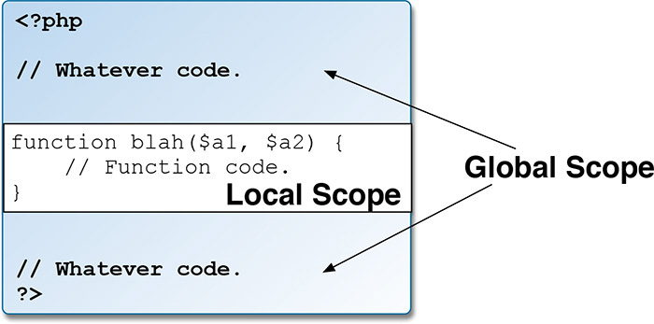
Understanding Variable Scope
The scope of a variable is the realm in which it exists.
A variable declared outside a function has a GLOBAL SCOPE and can only be accessed outside a function.
A variable declared within a function has a LOCAL SCOPE and can only be accessed within that function.
Global and Local Scope - https://www.w3schools.com/php/php_variables.asp

Slide 23
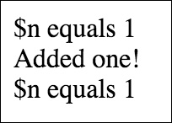
Understanding Variable Scope
A global variable declared outside a function is a different entity than a local variable declared inside a function.
Even if the two variables use the exact same name.
For example.
function add_one($n) {
$n++;
print 'Added one!<br>';
}
$n = 1;
print "\$n equals $n<br>";
add_one($n);
print "\$n equals $n<br>";

Slide 24

Try it yourself
// Create the function.
function add_one($n) {
$n++;
print "Added one! Local \$n equals $n<br>";
}
// Call the function.
$n = 1;
print "Global \$n equals $n<br>";
add_one($n);
print "Global \$n equals $n<br>";
phpfiddle.org

Slide 25
Understanding Variable Scope
To make a variable external to a function available within the function by using the global statement.
The syntax of the global statement is.
function function_name($args) {
global $variable;
statement(s);
}
For example.
$var1 = 1;
function foo() {
global $var1;
$var1 = 2;
print $var1;
}
foo();

Slide 26
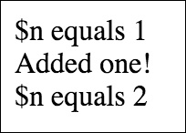
Understanding Variable Scope
Using the global statement makes the two variable the same.
For example.
function add_one() {
global $n; // Same!
$n++;
print 'Added one!<br>';
}
$n = 1;
print "\$n equals $n<br>";
add_one();
print "\$n equals $n<br>";

Slide 27
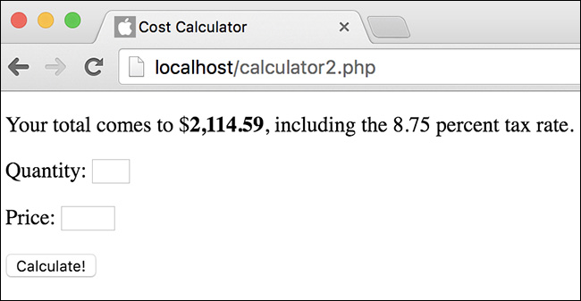
To use the global statement
Code from calculator2.php (Script 10.5).
Use the $tax variable in the function.
$tax = 8.75;
function calculate_total ($quantity, $price) { global $tax; $total = $quantity * $price; // Calculation $taxrate = ($tax / 100) + 1; $total = $total * $taxrate; // Add the tax. $total = number_format ($total, 2); // Formatting return $total; // Return the value. } // End of function.
Call the function.
$total = calculate_total($_POST['quantity'], $_POST['price']);
print "<p>Your total comes to $<span style=\"font-weight: bold;\">$total</span>, including the $tax percent tax rate.</p>";

Slide 28
Function Design Theory
A proper user-defined function should be easily reusable and be likely to be reused.
If a website only ever calls a function once, there’s no need for it.
There should also be a “black box” mentality about the function.
A programmer shouldn’t need to know about the internals of a function in order to use it properly.
Proper function design suggests that you should be extremely cautious when using global variables.
A function should be passed all the information it needs, so that global variables not required.
By writing functions that neither rely on global variables nor make assumptions as to what outside of the function is true, you make the function more independent and portable.

